Slide 1
Agile Project Management

Slide 2
Shared and Focused Responsibility
Agile project management divides responsibility among more than one team member.
In the case of Scrum, it’s a project's product owner, Scrum Master and the rest of the team.

Slide 3
The product owner is responsible for the business aspects of the project, including ensuring the right product is being built, and in the right order
The Scrum Master serves as the team's coach, helping team members work together in the most effective manner possible.

Slide 4
The team itself assumes agile project management roles when determining how to best achieve the product goals (as established by the product owner).
Team members will collaboratively decide which person should work on which tasks, which technical practices are necessary to achieve stated quality goals, and so on.

Slide 5
Scrum Master Role
In agile project management, the world may come to view the ScrumMaster as a 21st century version of the project manager.
But unlike a traditional project manager, the ScrumMaster is not viewed as the person to credit (or blame) for the success (or failure) of the project.

Slide 6
Do Agile Projects Scale with Project Management
Agile processes like Scrum are definitely scalable.
While the typical agile project has between five and 20 people across one to three teams, agile implementation has been successful on projects with 200 to 500 – even 1,000 people.
E.g. IBM, Microsoft , Sales Force, Accenture , Google.

Slide 7
But Still Project Management Done by Team
To coordinate the work of many teams, larger projects sometimes include a role called “project manager.” While involving someone on the project with this title or background can be very helpful, we need to be careful of the baggage associated with the project manager title.

Slide 8
But Still Project Management Done by Team
Even on a very large agile project, the team will still do much of the project management. For example, teams decide how to allocate tasks, not a project manager;

Slide 9
Duties of Agile PM would include
Allocating and tracking the budget;
Communicating with outside stakeholders, contractors and others;
Maintaining the risk census with guidance from the teams, ScrumMasters and product owners; and so on.
This is a true agile project management role.

Slide 10
Success Stories ( IBM, Sales Force, Dell)
http://www.slideshare.net/vmysla/scrum-at-spotify?qid=c2829ef4-22b0-4a7a-aad7-20ce45271f9b&v=qf1&b=&from_search=1
http://www.slideshare.net/TechWellPresentations/scaling-agile-at-dell-reallife-problems-and-solutions-29090880?qid=89e98ede-e0c2-4358-83df-50c43da1243d&v=default&b=&from_search=1
http://www.slideshare.net/sgreene/agile-2010-conference-a-holistic-approach-to-scaling-agile-at-salesforce?qid=d831176f-ba0e-49b3-9ca4-e604601a5f63&v=default&b=&from_search=1

Slide 11
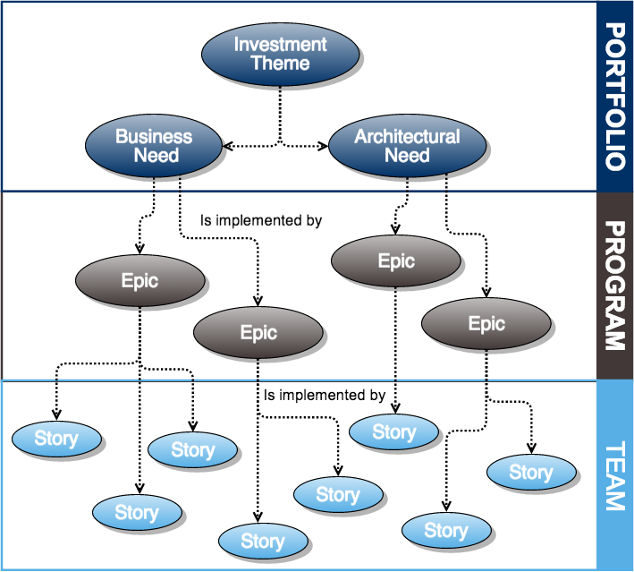
Frameworks for Scaling Agile
Scaled Agile Framework

Slide 12
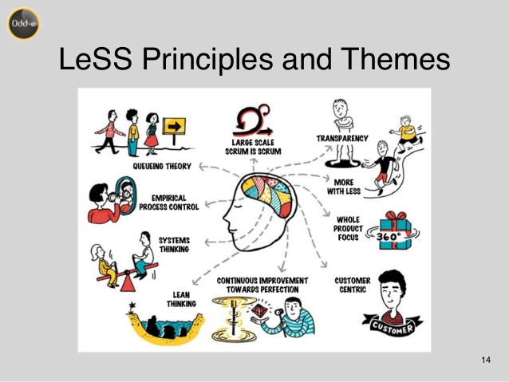
Frameworks for Scaling Agile
Large Scale Scrum

Slide 13
Do not Change Fundamentals of Agile
Transparency
Inspection
Adaption
Self Organizing team & Flat hierarchy
Continuous Delivery and Deployment

